Slide 1


Huazhong University of Science and Technology
The Department of Electronics and Information Engineering
Electronic Circuit Analysis and Design
Dr. Tianping Deng
Email: dengtp@hust.edu.cn

Slide 2
Contents
PART 1 SEMICONDUCTOR DEVICES AND BASIC APPLICATIONS
Chapter 1 Semiconductor Materials and Diodes
Chapter 2 Diode Circuits
Chapter 3 The Field-Effect Transistor
Chapter 4 Basic FET Amplifiers
Chapter 5 The Bipolar Junction Transistor
Chapter 6 Basic BJT Amplifiers
Chapter 7 Frequency Response
Chapter 8 Output Stages and Power Amplifiers
PART 2 ANALOG ELECTRONICS
Chapter 9 Ideal Operational Amplifiers and Op-Amp Circuits
Chapter 10 Integrated Circuit Biasing and Active Loads
Chapter 11 Differential and Multistage Amplifiers
Chapter 12 Feedback and Stability
Chapter 13 Operational Amplifier Circuits
Chapter 14 Nonideal Effects in Operational Amplifier Circuits
Chapter 15 Applications and Design of Integrated Circuits
P 7~39
Chapter 9 Ideal Operational Amplifiers and Op-Amp Circuits

Slide 3
Ch9 The Ideal Operational Amplifier
9.0 Preview
9.1 The Operational Amplifier
9.2 Inverting Amplifier
9.3 Summing Amplifier
9.4 Noninverting Amplifier
9.5 Op-Amp Application

Slide 4
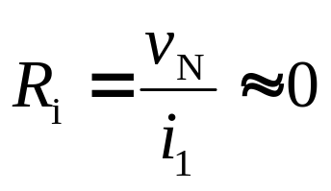

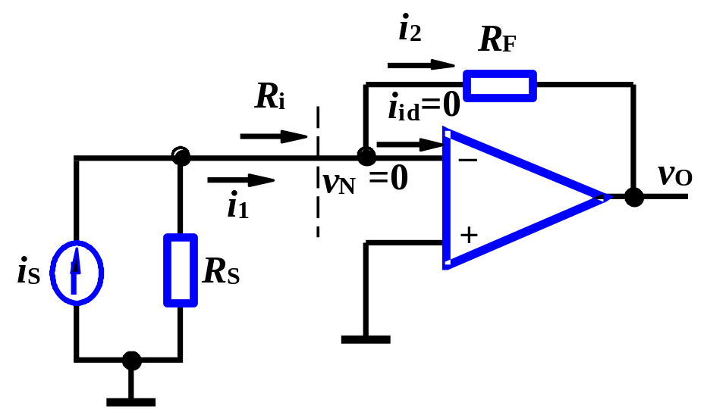
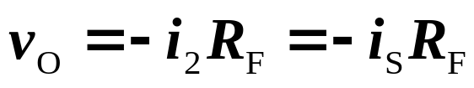
The circuit converts current into voltage, that is, v_{O} is directly proportional to i_{S} .
Input resistance
So, i₁= i_{S} , and i₂= i₁= i_{S}
Feedback resistance R_{F} is magnitude of ratio.

Slide 5
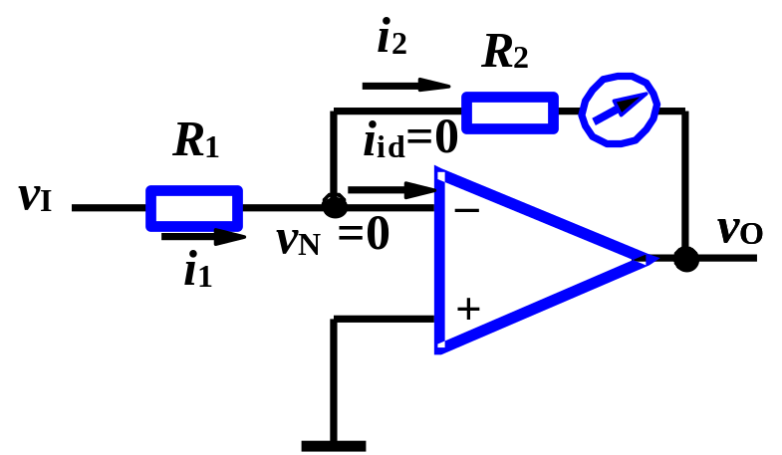
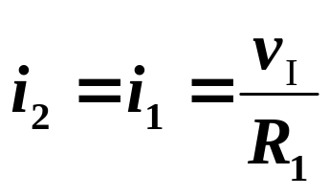
Circuit in fig.2 converts voltage into current, i₂ is directly proportional to v_{I} .
But one side of load is not at ground potential, so the circuit would not be practical for some applications.

Slide 6
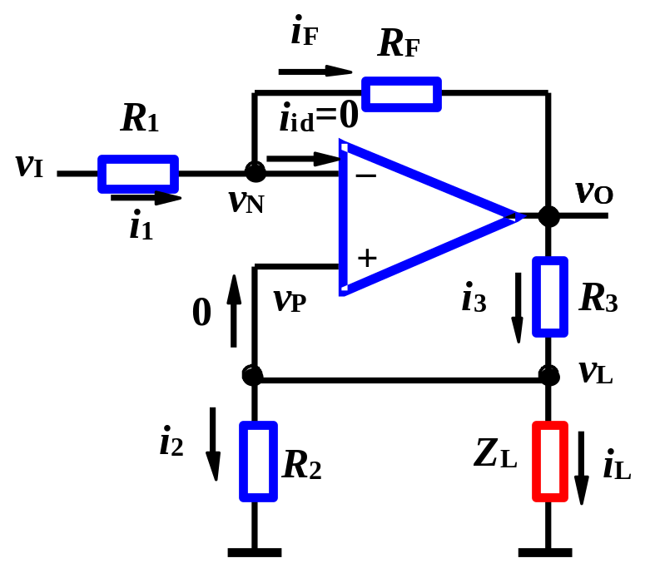
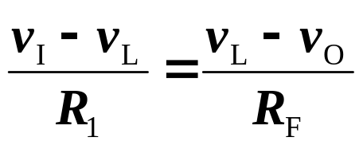
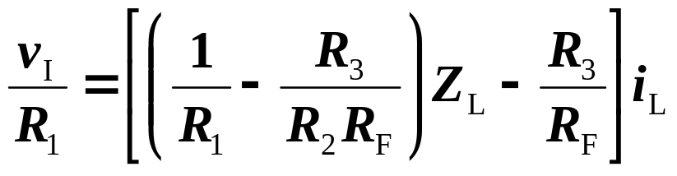
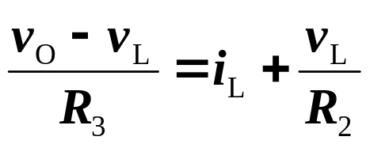
Circuit in fig.3 has load impedance Z_{L}, which one terminal is at ground potential.
From virtual short, get v_{N}=v_{P}= v_{L}= Z_{L}i_{L}
Using KCL at N and P nodes, get
In order to make i_{L} independent of Z_{L}, set coefficient of Z_{L} zero.

Slide 7


Which means load current is proportional to input voltage, and independent of Z_{L}.

Slide 8
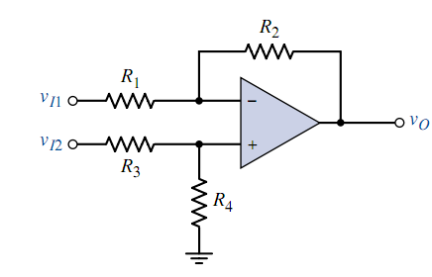




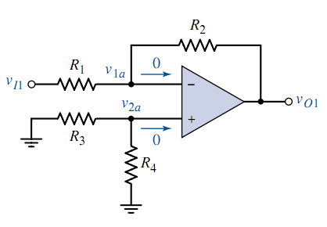
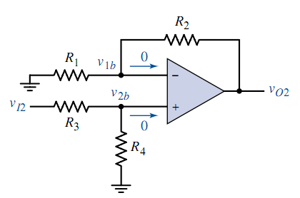


Slide 9

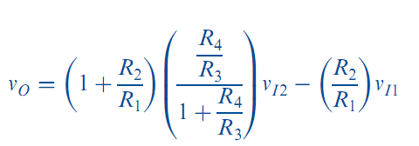

Slide 10
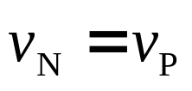
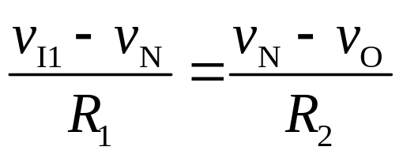
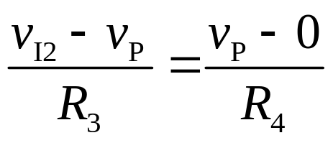

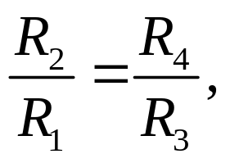


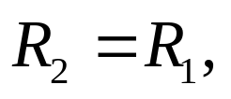
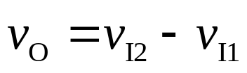
According to virtual short, using KCL at N、P nodes:
When
If
Then

Slide 11
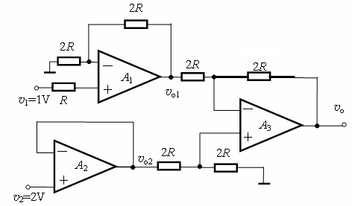


Assume all the Op-Amps are ideal, Find v_{O}.
Noninverting
Difference
Follower

Slide 12

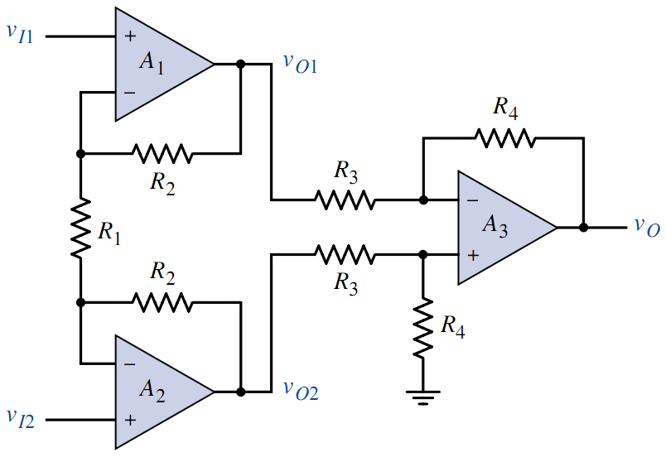

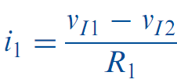
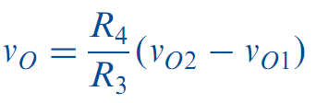
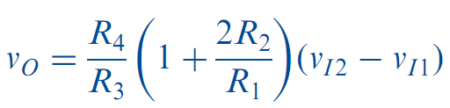

Slide 13
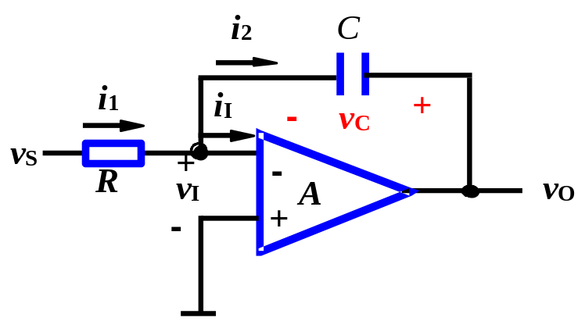



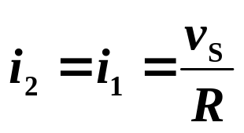
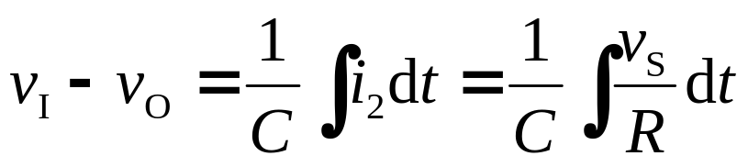
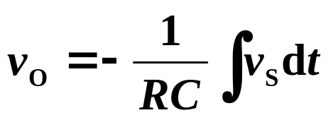
Using virtual short, get
That is,
and
So,
Integrator
Capacitor is charged, and current is i₂ .
Assume initial voltage of C is 0.
The minus sign indicates v_{O} is out of phase to v_{S} by 180°.

Slide 14
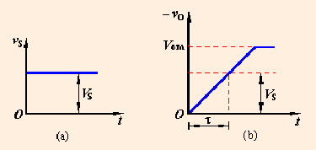
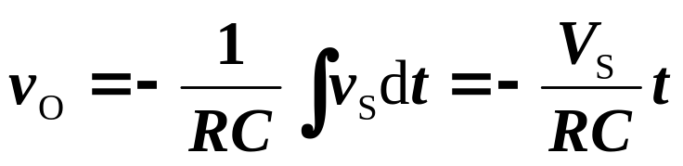
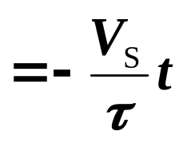
v_{S} is a finite step function.
Output v_{O} is a ramp function.
an inclined surface connecting two levels
v_{O} is a linear function of time t.
Output v_{O} is a ramp function.
It will eventually saturate at a V_{OM}, which is near either positive or negative supply voltage.
C is open for dc value, v_{O} will be ±V_{OM}, the resistor needs to be parallel with C.

Slide 15
u_{i}
The input signal is step signal.
0
t
u_{o}
Output vO is a ramp function.
0
τ
t
u_{i}
The input signal is square wave.
0
t
u_{o}
The output signal is triangle-wave.
t
0
How to select the time constant, larger or less?

Slide 16
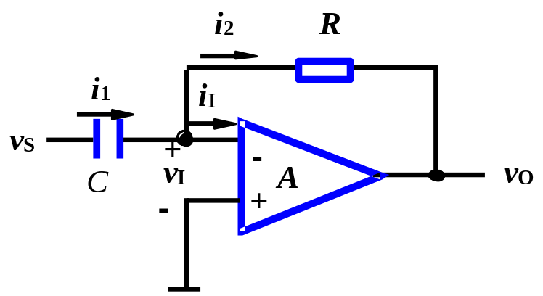
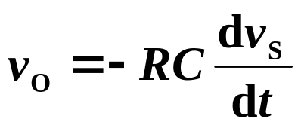
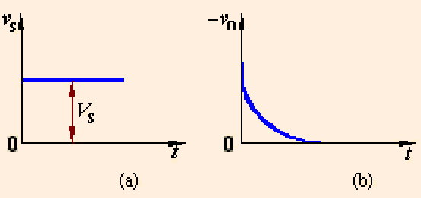
v_{S} is a step function.
Output v_{O} is a pulse function.
Differentiator
If v_{S}=sinωt, v_{O}=−RCωcosωt.
|v_{O}| increases with ω.
Differentiator is more susceptible to noise than integrator.
The problem is alleviated by placing a resistor in series with C.

Slide 17
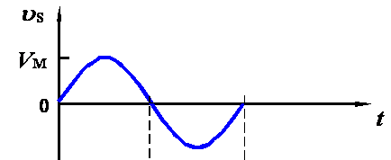
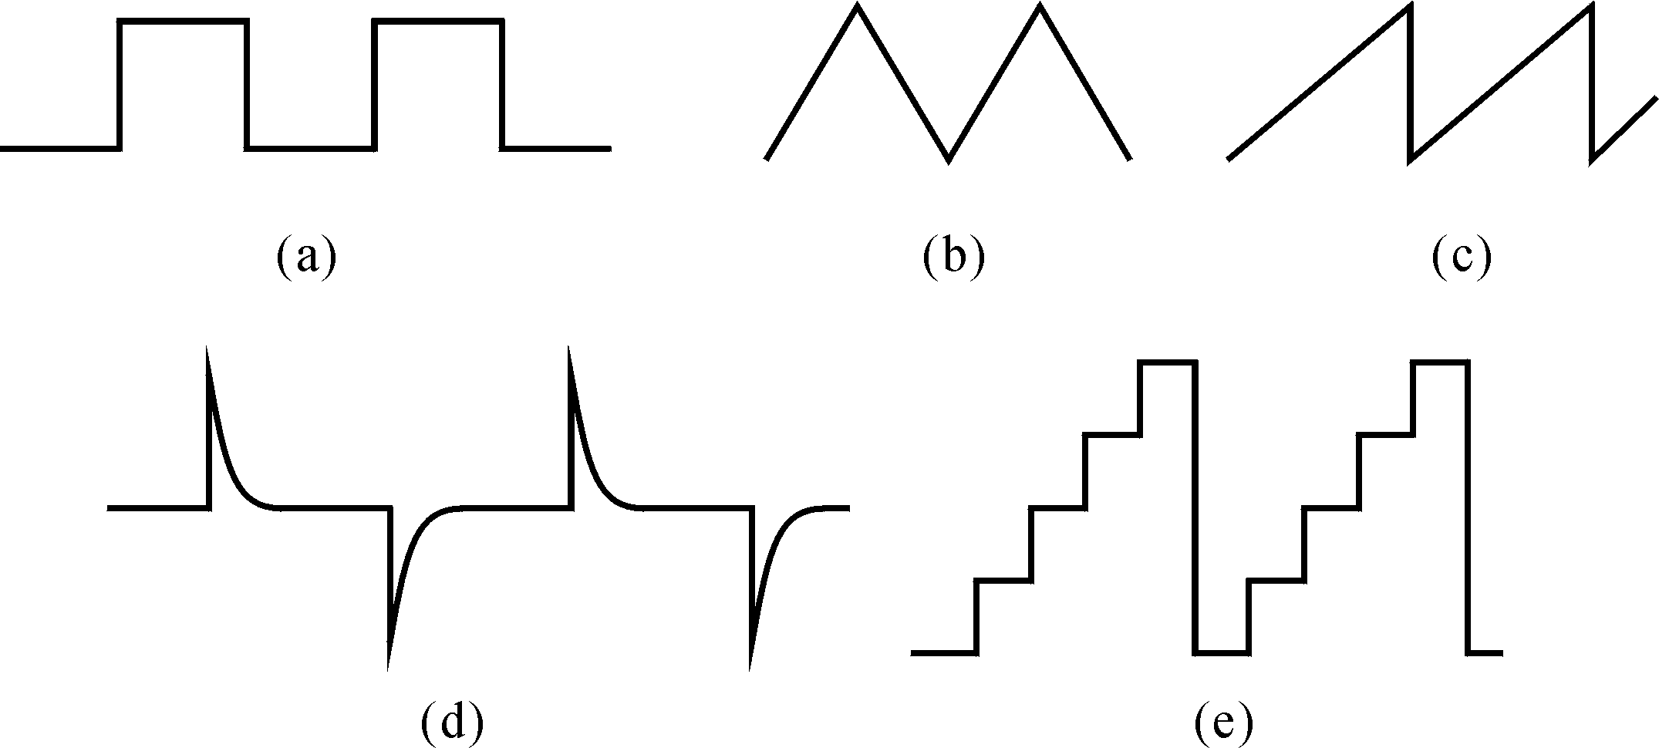
Sine wave
Comparators
triangle-wave
Saw tooth wave
Integrator
Differentiator

Slide 18
Example
The amplitude of the input signal of the A/D converter is 0 ~
+5V，now the amplitude of the original signal is -5V~+5V。
Design a circuit to implement this function.
v_{o}
v_{i}
design circuit
A/D
PC
+5V
+5V
+2.5V
-5V
v_{o} = 0.5v_{i}+2.5 V

Slide 19
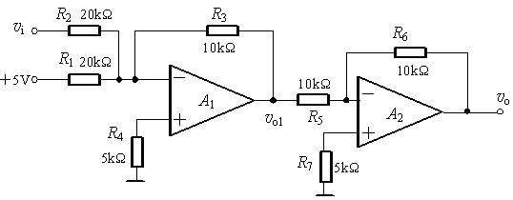
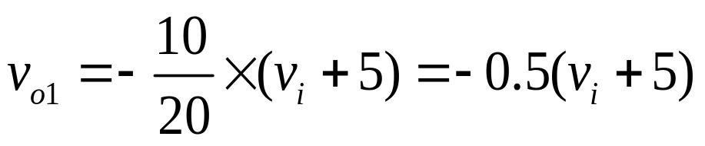
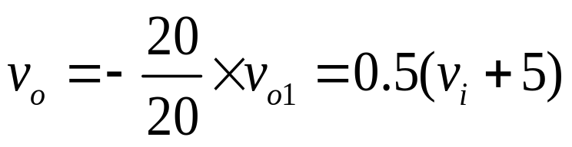
v_{o} =0.5v_{i} +2.5 V
=0.5 (v_{i} +5) V

Slide 20
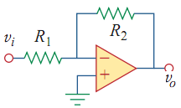


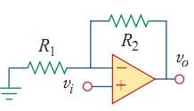



Slide 21
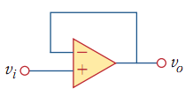

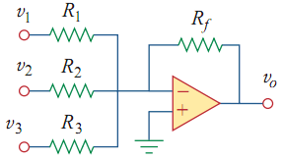


Slide 22
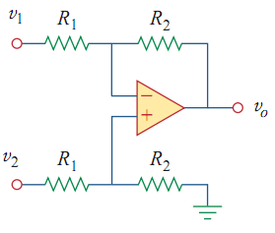


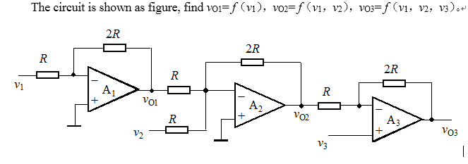

Slide 23
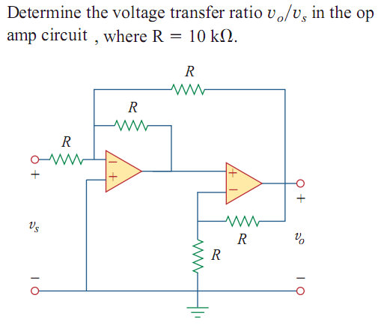


Slide 24
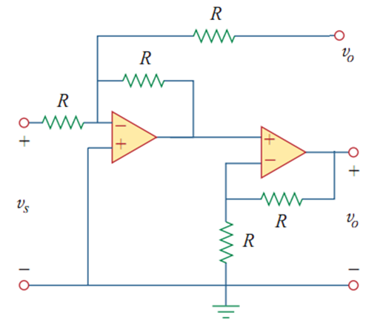
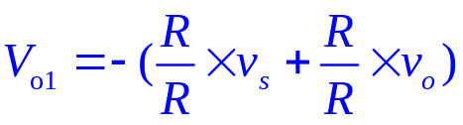
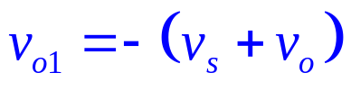
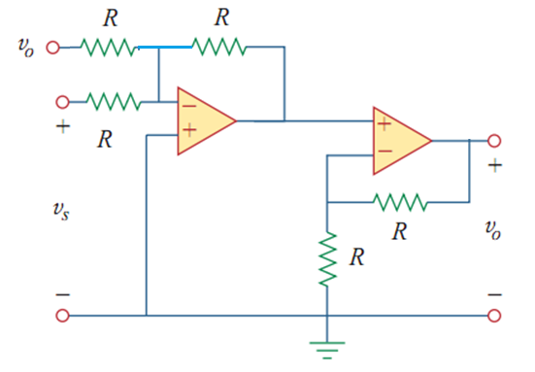






Slide 25




0
4V
7V
？
4V
0
4V
1V
？
1V
－4V
？
1V
－2V
＝4

Slide 26
Questions
and
Answers

